Slide 1
Hunt the Trojans
by Jonathan Ong, Ran Gross, and Quanjie Geng

Slide 2
Summary
An interactive cat and mouse Android app
Equipments
Server (Parse)
Android devices
Communication Methods
Wi-Fi, Cellular Data, Bluetooth

Slide 3
Game Logic
A player can either create a new game or join an existing game.
The player created the game is the cat and the players who joined the game are the mice
Cat and mice can request for the locations of everyone that is near them within a certain range
Locations are served once per 60 seconds for minute ping which both cat and mice have.
cat has a super ping that allows a request for locations once every 30 seconds.
A mouse is captured by the cat if Bluetooth connection between their devices is established.
If the cat captures all the mice within the time limit, the cat wins. Otherwise the mice win.

Slide 4





Tracking Locations
Locations
Locations

Slide 5
Bluetooth Capture
Bluetooth

Slide 6
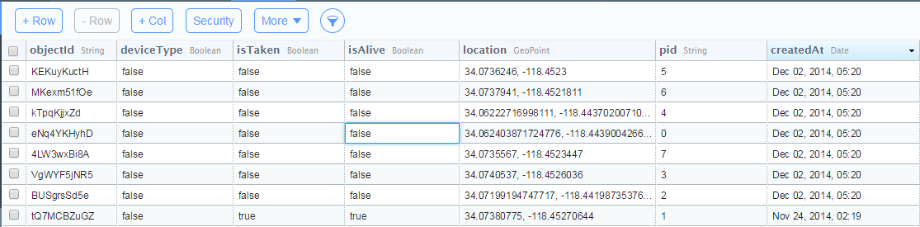
Parse
The server chosen to store data for the game.
Data stored includes:
ID of each device
whether a device ID is taken or not
whether the player is dead or alive
The locations of each device
Uses a set of queries to get data that was previously stored on the server to use for the map.

Slide 7
Google Map
A high level API that let us create a map
Move camera across the map
Zoom in or out
Draw markers
Display the device location

Slide 8
Ran’s Contribution
wrote the code that lets the app access the parse server.
organized the server inputs and defined the entries for the table
worked on the code for part of the game logic, different activity displays, layout of the app, and integrating the server code into the rest of the app.
For the map:
upload and download of location data that is currently allowed to be viewed
For the game logic:
upload and check conditions on the server to see if we can:
make a game
join a game
won/lost a game

Slide 9
Nero’s Contribution
Use the Google Map API to create a map in the app
Acquire the device’s current location through Wi-Fi or GPS
Update current location through a location listener
Draw a marker on the map with a location as input
Integrate Parse API for upload and download (from Ran)
Put the device’s current location on Parse as current location updates
Download the locations of other devices from Parse and draw markers for those locations upon player’s request

Slide 10
Jonathan’s Contributions
slacking
leeching

Slide 11
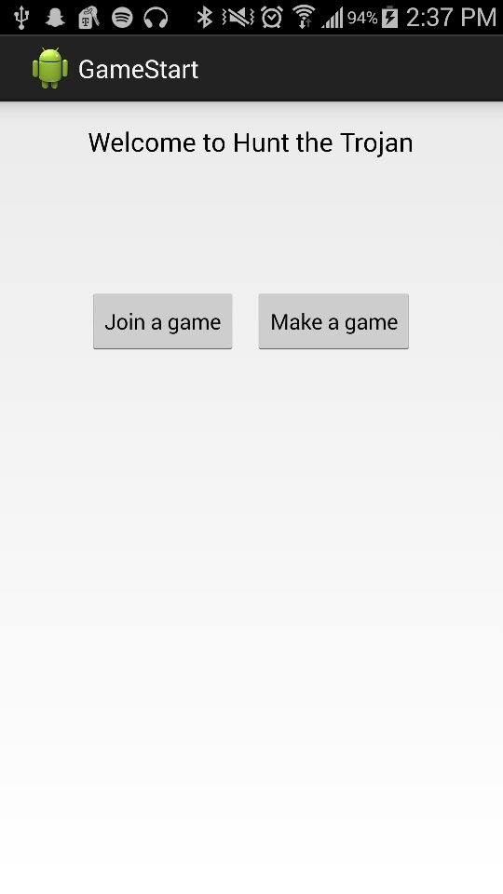
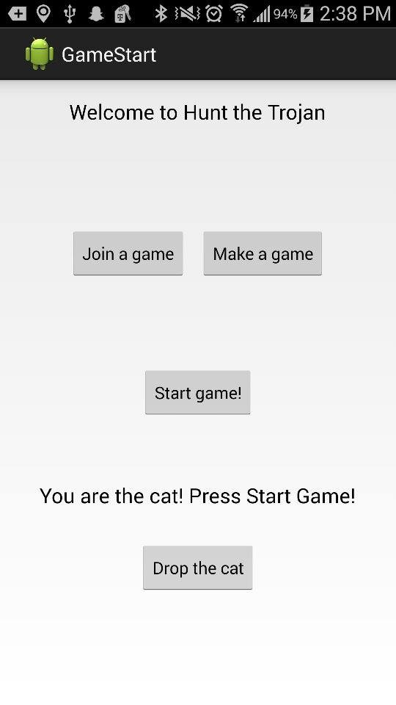
Screenshots - Start

Slide 12
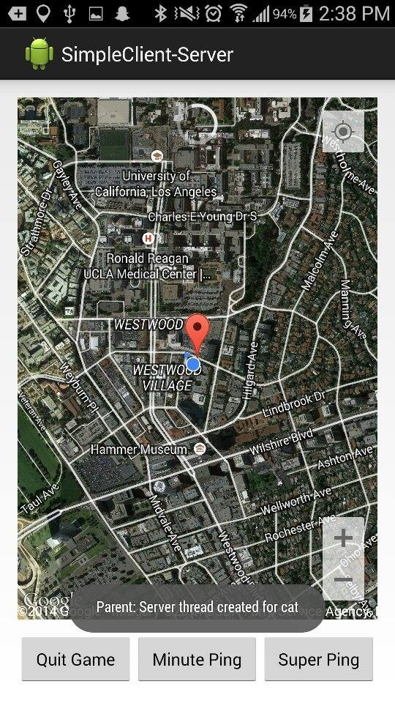
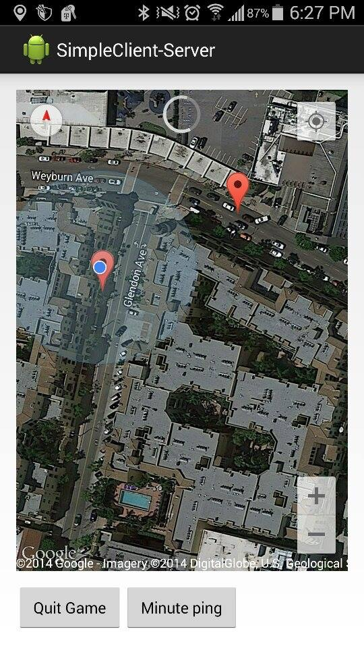
Screenshots - Map

Slide 13
Q&A
Thank you!

